Slide 1
No Free Lunch
A Palatable Project Presentation by:
Samruddhi Somani, Leon Chen, Daniel Lai, Andrew Reuben, Bejan Sadeghian
Group 11

Slide 2
Problem / Business Case
Can the cuisine of a recipe be identified based on ingredients?
What ingredients are predictive?
Possible applications:
more targeted recommendations
Understand which cuisines are similar

Slide 3
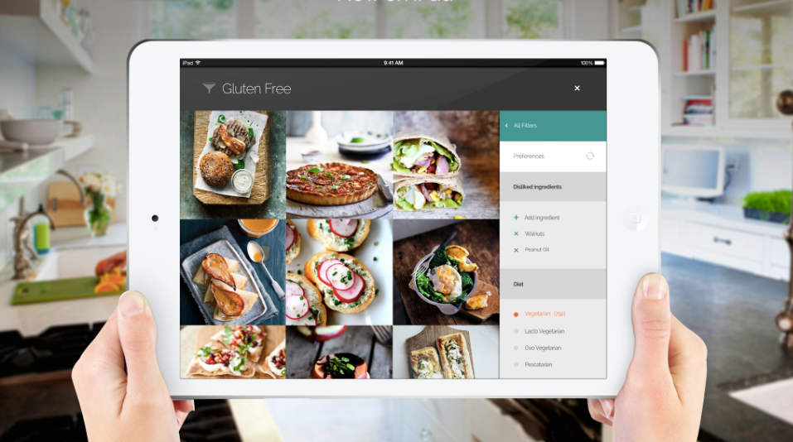
What is Yummly?
Recommends recipes posted online based on your preferences and feedback
There are millions of pasta-bilities!
Pandora for your Pinterest food board
Notes:
-can choose ingredients you have and they’ll show you what recipes you can make
-can upvote so rec engine will make recs

Slide 4
Data Description
Data provided by Yummly on Kaggle
Includes cuisine label and ingredients
Potential Issues: No directions or quantity information, nonstandardized ingredient names

Slide 5
Data Pre-Processing
Highly Sparse Dataset
Dimensionality Reduction
Use domain knowledge to filter dimensions
Ex. Diced Tomatoes == Cubed Tomatoes
IDF Transformation
Modulate importance of certain ingredients

Slide 6
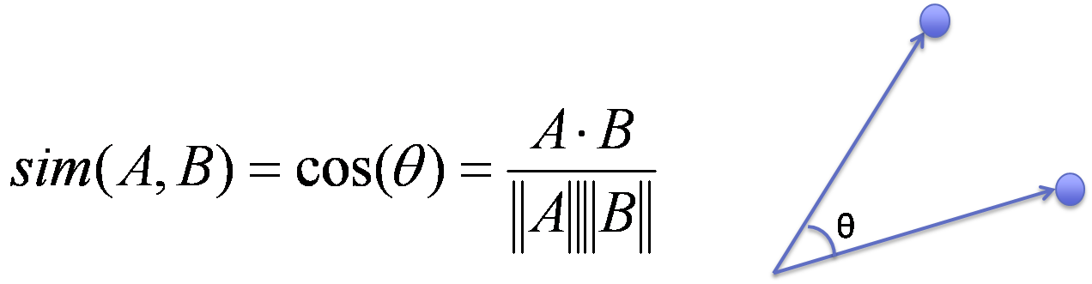
Models to be Used
K-Nearest Neighbors
Cosine Similarity - Differences in Recipe Sizes
Multinomial Naive Bayes
Using an IDF Transformation
LaPlace Smoothing
Linear Discriminant Analysis
Ensemble Methods
Random Forest
Boosted Trees

